Slide 1
Chemistry of Environment
Green Technology

Slide 2
GREEN CHEMISTRY
DEFINITION
Green Chemistry is the utilisation of a set of principles that reduces or eliminates the use or generation of hazardous substances in the design, manufacture and application of chemical products .

Slide 3
Green Chemistry Is About...
^{Waste}
^{Materials}
^{Hazard}
Reducing
^{Risk}
Energy
Cost

Slide 4
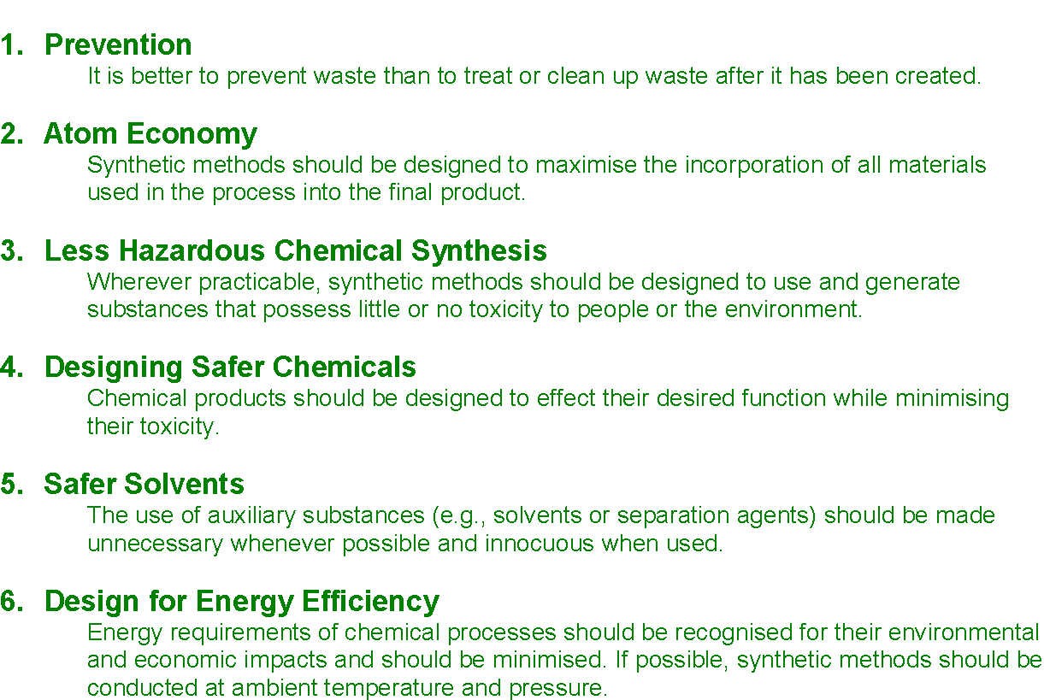
The 12 Principles of Green Chemistry (1-6)

Slide 5
The 12 Principles of Green Chemistry (7-12)
7 Use of Renewable Feedstocks
A raw material or feedstock should be renewable rather than depleting whenever technically and economically practicable.
eg. Vegetable oil+methanol=biodiesel+glycerine
8 Reduce Derivatives
Unnecessary derivatization (use of blocking groups, protection/de-protection, and temporary modification of physical/chemical processes) should be minimised or avoided if possible, because such steps require additional reagents and can generate waste.
9 Catalysis
Catalytic reagents (as selective as possible) are superior to stoichiometric reagents.
10 Design for Degradation
Chemical products should be designed so that at the end of their function they break down into innocuous degradation products and do not persist in the environment.
11 Real-time Analysis for Pollution Prevention
Analytical methodologies need to be further developed to allow for real-time, in-process monitoring and control prior to the formation of hazardous substances.
12 Inherently Safer Chemistry for Accident Prevention
Substances and the form of a substance used in a chemical process should be chosen to minimise the potential for chemical accidents, including releases, explosions, and fires.

Slide 6
1. Prevention
It is better to prevent waste than to treat or clean up waste after it is formed.

Slide 7
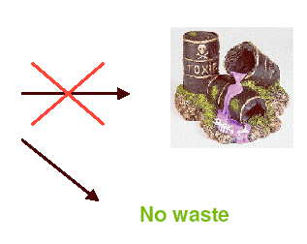
“It is better to prevent waste than to treat or clean up waste after it is formed”
Chemical
Process

Slide 8



GREEN DESIGNS Products that avoid using toxic materials Will not harm the humans or ecological system
eDiapers
Green Computers
Reusable diaper cover (the gPants)
Disposable (inserts)
100% biodegradable.
Environmentally friendly
Cheaper to manufacturer
Life span-30+ yrs.
Electrically efficient
Biodegradable recyclable and/or reusable parts
Made eco-friendly materials
LED Frog Lightbulbs

Slide 9
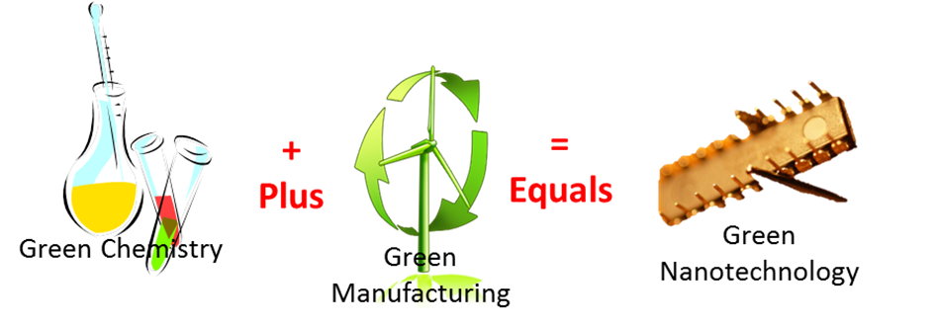


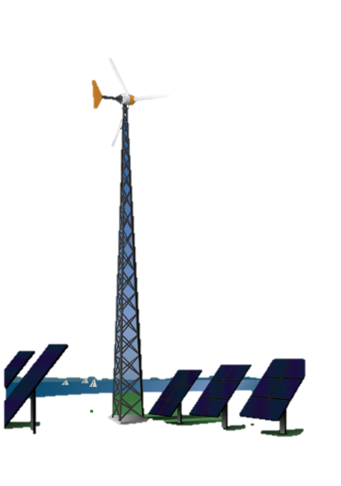
“Green technology” is in the early stage of development;
however it is becoming the new wave of society.
It encompasses an evolving group of methods and techniques;
Such as
“Greening” Technology
Manufacturing of Green Designs
The Expectation:
To change the daily habitual habits of society.
Incorporating Renewable Energy or Alternatives
The Goal:
To be Sustainable for everyone everyday
Notes:
We must be able to sustain our renewable energy and alternative resources in a way that will not harm the planet.

Slide 10



EDIAPERS COMES IN DIFFERENT
COLORS & SIZES
FEATURES LOWER POWER CONSUMPTION
CAN BE FLUSHED-COMPOSTED
Reducing waste by changing patterns of production
LED FROG LIGHTBULBS
TIES IN WITH TRADITIONAL LIGHTBULB
REQUIRES NO HARMFUL CHEMICAL TO PRODUCE
DESIGNED FOR DISASSEMBLY SO THAT IT CAN EASILY BE BROKEN DOWN AND RECYCLED
The invention, design, and execution of such products are vital to GREEN TECHNOLOGY

Slide 11
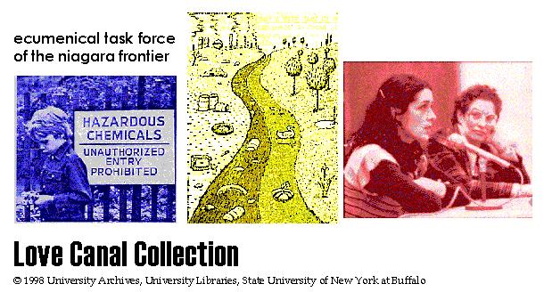
Environmental Disasters
Love Canal
in Niagara Falls, NY a chemical and plastics company had used an old canal bed as a chemical dump from 1930s to 1950s. The land was then used for a new school and housing track. The chemicals leaked through a clay cap that sealed the dump. It was contaminated with at least 82 chemicals (benzene, chlorinated hydrocarbons, dioxin). Health effects of the people living there included: high birth defect incidence and siezure-inducing nervous disease among the children.
http://ublib.buffalo.edu/libraries/projects/lovecanal/

Slide 12
2. Atom Economy
Synthetic methods should be designed to maximize the incorporation of all materials used in the process into the final product.

Slide 13
Percent yield:
Percent yield:
% yield = (actual yield/theoretical yield) x 100
What is missing?
What co-products are made?
How much waste is generated?
Is the waste benign waste?
Are the co-products benign and/or useable? How much energy is required?
Are purification steps needed?
What solvents are used? (are they benign and/or reusable?
Is the “catalyst” truly a catalyst? (stoichiometric vs. catalytic?)

Slide 14
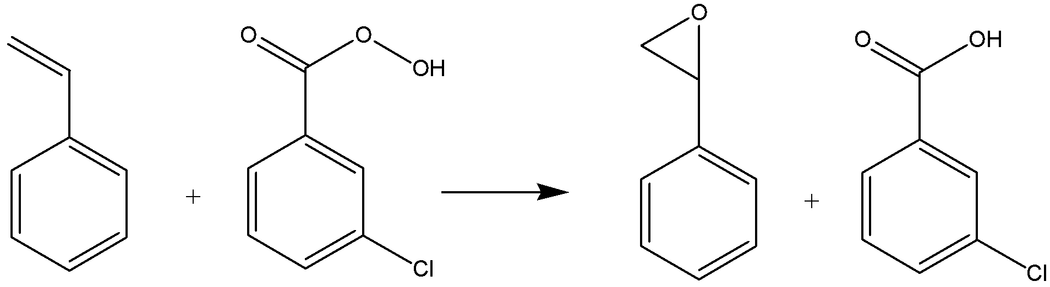
Balanced Reactions
Balanced chemical reaction of the epoxidation of styrene

Slide 15
Atom Economy:
Atom Economy
% AE = (MW of Desired Product/MW of all reactants) X 100
Balanced Equations
Focuses on the reagents
Stoichiometry?
How efficient is the reaction in practice?
Solvents?
Energy?

Slide 16
Atom Economy
Balanced chemical reaction of the epoxidation of styrene
Assume 100% yield.
100% of the desired epoxide product is recovered.
100% formation of the co-product: m-chlorobenzoic acid
A.E. of this reaction is 23%.
77% of the products are waste.

Slide 17
3. Less Hazardous Chemical Synthesis
Whenever practicable, synthetic methodologies should be designed to use and generate substances that possess little or no toxicity to human health and the environment.

Slide 18

Less Hazardous Chemical Synthesis
Polycarbonate Synthesis: Phosgene Process
Disadvantages
phosgene is highly toxic, corrosive
requires large amount of CH₂Cl₂
polycarbonate contaminated with Cl impurities

Slide 19

Less Hazardous Chemical Synthesis
Polycarbonate Synthesis: Solid-State Process
Advantages
diphenylcarbonate synthesized without phosgene
eliminates use of CH₂Cl₂
higher-quality polycarbonates

Slide 20
Alternative Synthetic Pathways Award Flexsys America L.P. New Process for 4-Aminodiphenylamine
Academic Award Terrence J. Collins Carnegie Mellon University TAML™ Oxidant Activators: General Activation of Hydrogen Peroxide for Green Oxidation Technologies
Eliminate use of acids to break initial bonds
Phosgene replacement

Slide 21
4. Designing Safer Chemicals
Chemical products should be designed to preserve efficacy of the function while reducing toxicity.

Slide 22

Designing Safer Chemicals Case Study: Antifoulants (Marine Pesticides)

Slide 23
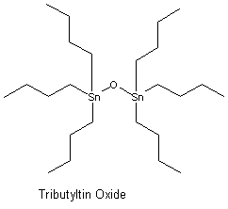
Designing Safer Chemicals: Case Study: Antifoulants
Antifoulants are generally dispersed in the paint as it is applied to the hull. Organotin compounds have traditionally been used, particularly tributyltin oxide (TBTO). TBTO works by gradually leaching from the hull killing the fouling organisms in the surrounding area
TBTO and other organotin antifoulants have long half-lives in the environment (half-life of TBTO in seawater is > 6 months). They also bioconcentrate in marine organisms (the concentration of TBTO in marine organisms to be 104 times greater than in the surrounding water).
Organotin compounds are chronically toxic to marine life and can enter food chain. They are bioaccumulative.

Slide 24
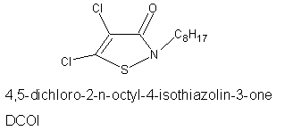
Designing Safer Chemicals: Case Study: Antifoulants
Presidential Green Chemistry Challenge Award, 1996
The active ingredient in Sea-Nine® 211, 4,5-dichloro-2-n-octyl-4-isothiazolin-3-one (DCOI), is a member of the isothiazolone family of antifoulants.

Slide 25
5. Safer Solvents and Auxiliaries
The use of auxiliary substances (solvents, separation agents, etc.) should be made unnecessary whenever possible and, when used, innocuous.

Slide 26
Solvent Selection
Preferred | Useable | Undesirable
Water | Cyclohexane | Pentane
Acetone | Heptane | Hexane(s)
Ethanol | Toluene | Di-isopropyl ether
2-Propanol | Methylcyclohexane | Diethyl ether
1-Propanol | Methyl t-butyl ether | Dichloromethane
Ethyl acetate | Isooctane | Dichloroethane
Isopropyl acetate | Acetonitrile | Chloroform
Methanol | 2-MethylTHF | Dimethyl formamide
Methyl ethyl ketone | Tetrahydrofuran | N-Methylpyrrolidinone
1-Butanol | Xylenes | Pyridine
t-Butanol | Dimethyl sulfoxide | Dimethyl acetate
 | Acetic acid | Dioxane
 | Ethylene glycol | Dimethoxyethane
 |  | Benzene
 |  | Carbon tetrachloride
“Green chemistry tools to influence a medicinal chemistry and research chemistry based organization”
Dunn and Perry, et. al., Green Chem., 2008, 10, 31-36

Slide 27
Solvent replacement table
Undesirable Solvent | Alternative
Pentane | Heptane
Hexane(s) | Heptane
Di-isopropyl ether or diethyl ether | 2-MeTHF or tert-butyl methyl ether
Dioxane or dimethoxyethane | 2-MeTHF or tert-butyl methyl ether
Chloroform, dichloroethane or carbon tetrachloride | Dichloromethane
Dimethyl formamide, dimethyl acetamide or N-methylpyrrolidinone | Acetonitrile
Pyridine | Et₃N (if pyridine is used as a base)
Dichloromethane (extractions) | EtOAc, MTBE, toluene, 2-MeTHF
Dichloromethane (chromatography) | EtOAc/heptane
Benzene | Toluene
“Green chemistry tools to influence a medicinal chemistry and research chemistry based organization”
Dunn and Perry, et. al., Green Chem., 2008, 10, 31-36

Slide 28
6. Design for Energy Efficiency
Energy requirements should be recognized for their environmental and economic impacts and should be minimized. Synthetic methods should be conducted at ambient temperature and pressure.

Slide 29
Energy in a chemical process
Thermal (electric)
Cooling (water condensers, water circulators)
Distillation
Photo
Microwave
Source of energy:
Power plant – coal, oil, natural gas

Slide 30
Energy usage
Chemicals and petroleum industries account for 50% of industrial energy usage.
~1/4 of the energy used is consumed in distillation and drying processes.

Slide 31
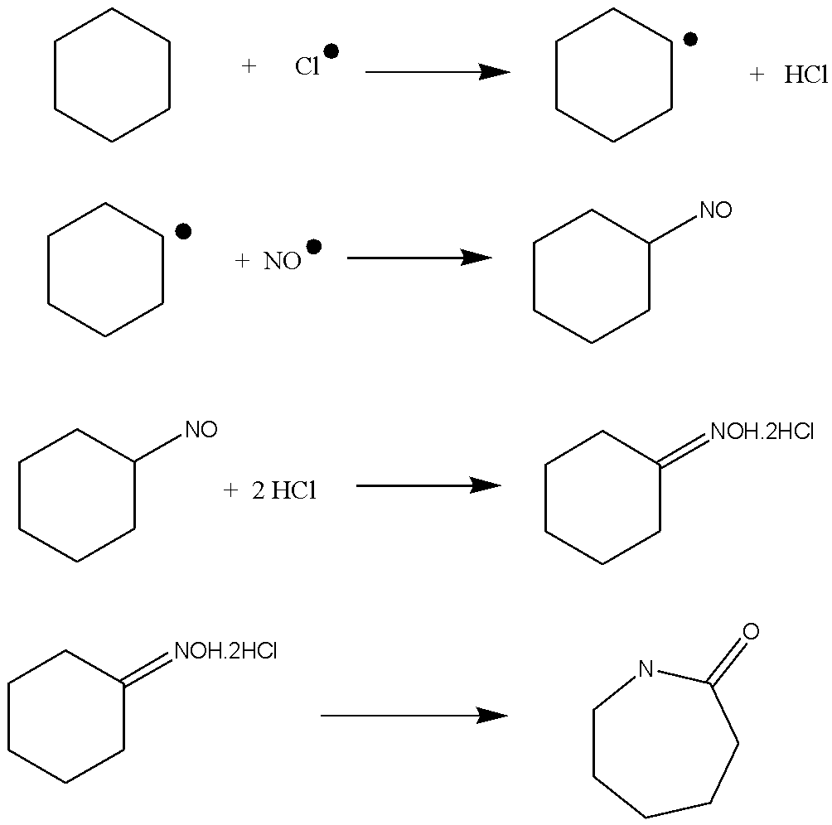
Alternative energy sources: Photochemical Reactions
Two commercial photochemical processes (Caprolactam process & vitamin D3)
Caprolactam process
NOCl → NO˙ + Cl˙ (535nm)
Notes:
Vitamin D3: Photochemical electrocyclic ring opening followed by a thermal 1,7-hydride shift
no viable thermal alternative

Slide 32
Alternative Energy Sources: Microwave chemistry
Wavelengths between 1 mm and 1 m
Frequency fixed at 2.45 GHz
More directed source of energy
Heating rate of 10°C per second is achievable
Possibility of overheating (explosions)
Solvent-free conditions are possible
Interaction with matter characterized by penetration depth

Slide 33
7. Use of Renewable Feedstocks
A raw material or feedstock should be renewable rather than depleting whenever technically and economically practical.

Slide 34
Biomaterials [Carbohydrates, Proteins, Lipids]
Highly Functionalized Molecules
Petroleum Products [Hydrocarbons]
Singly Functionalized Compounds [Olefins, Alkylchlorides]
Highly Functionalized Molecules

Slide 35
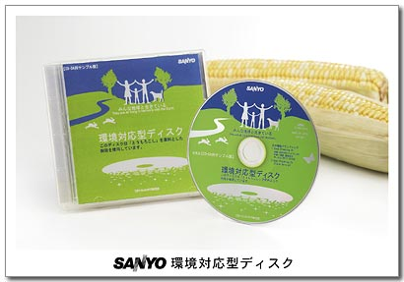
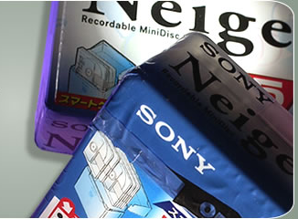
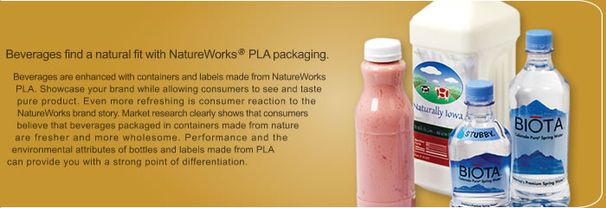
Polymers from Renewable Resources: Poly(lactic acid)

Slide 36
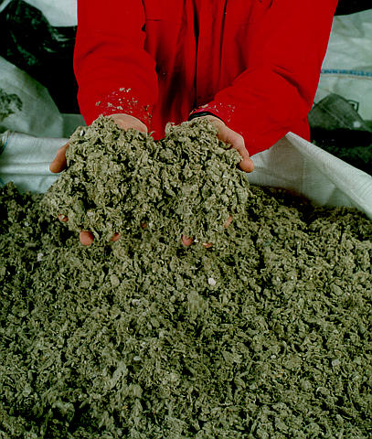
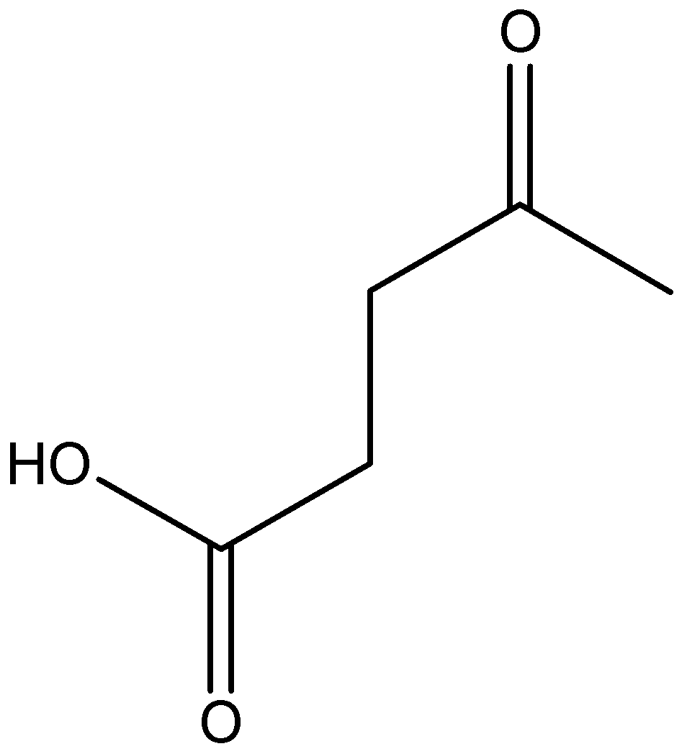


Raw Materials from Renewable Resources: The BioFine Process
Paper mill
sludge
Agricultural
residues,
Waste wood
Levulinic acid
Green Chemistry Challenge Award 1999 Small Business Award
Municipal solid waste
and waste paper

Slide 37
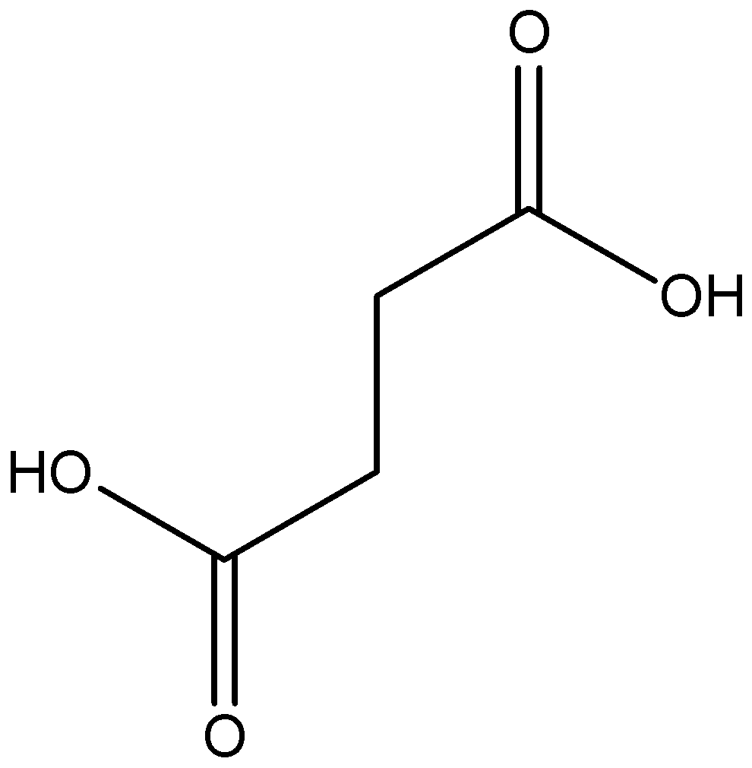
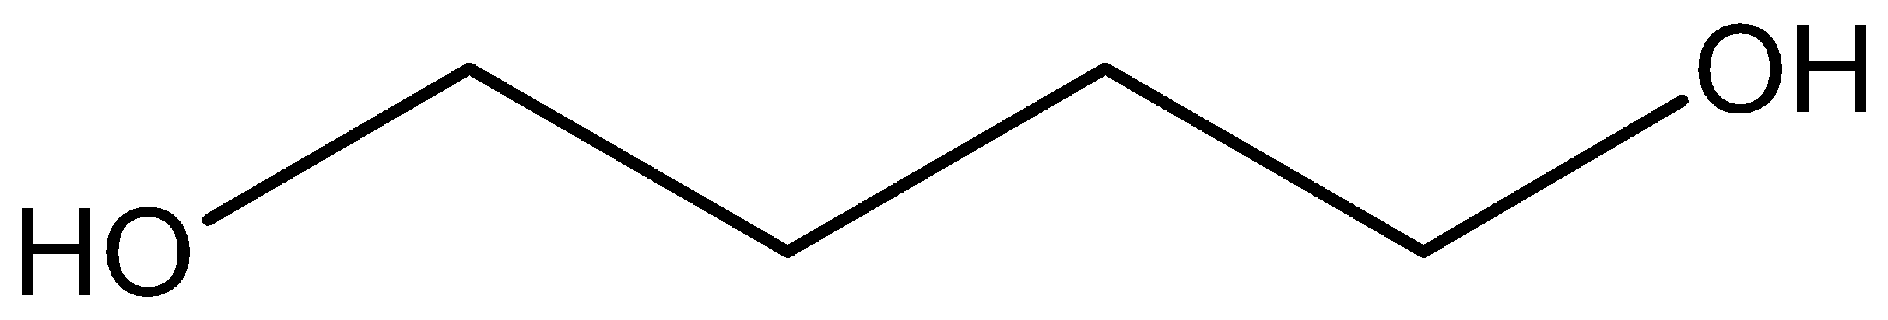
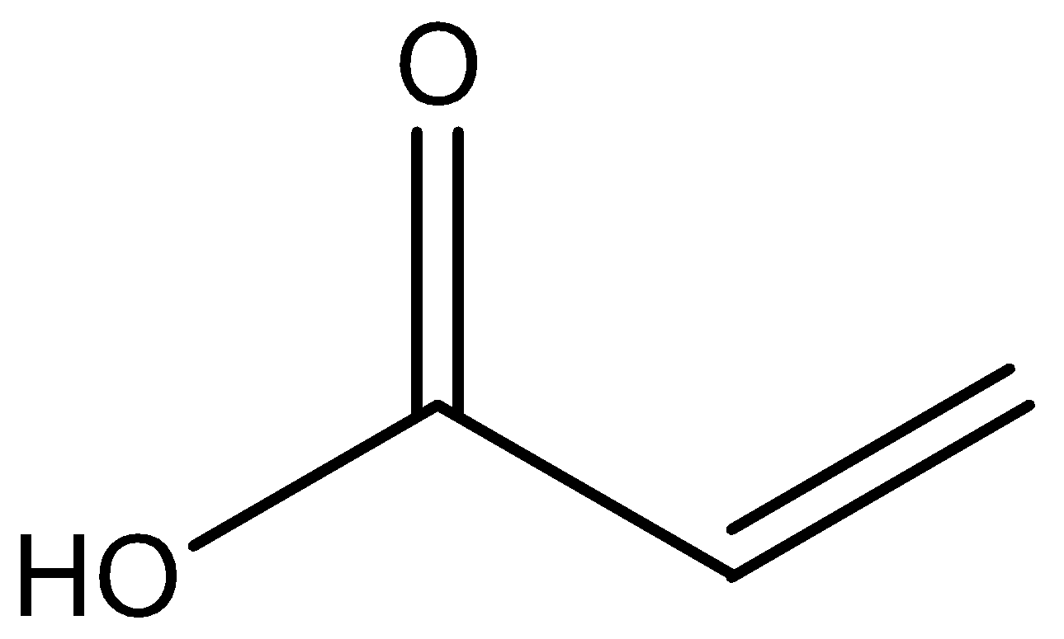
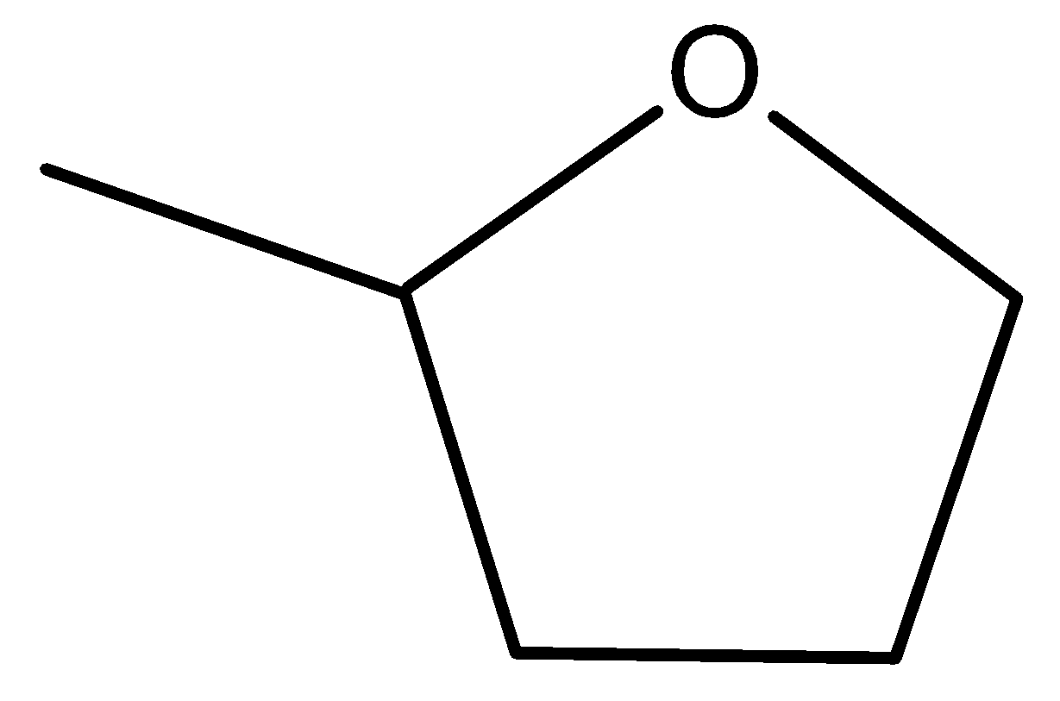
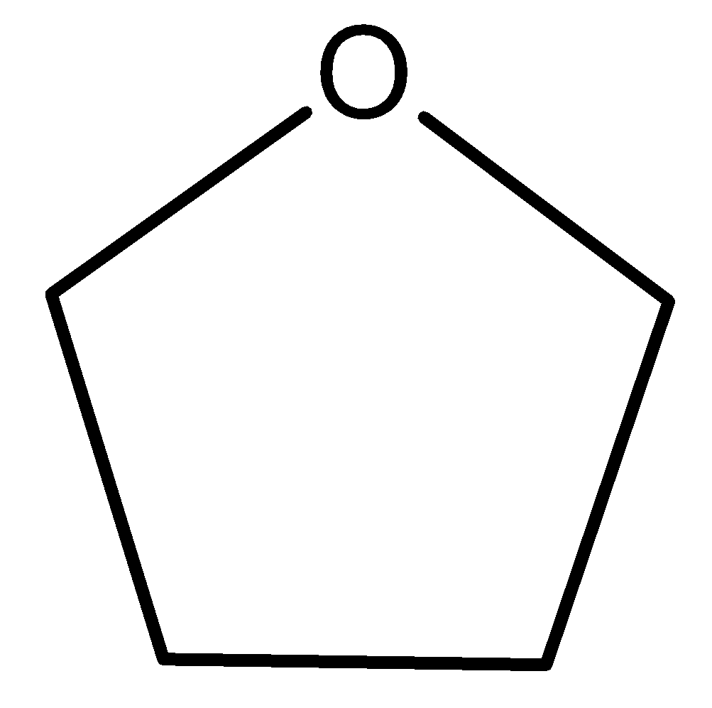
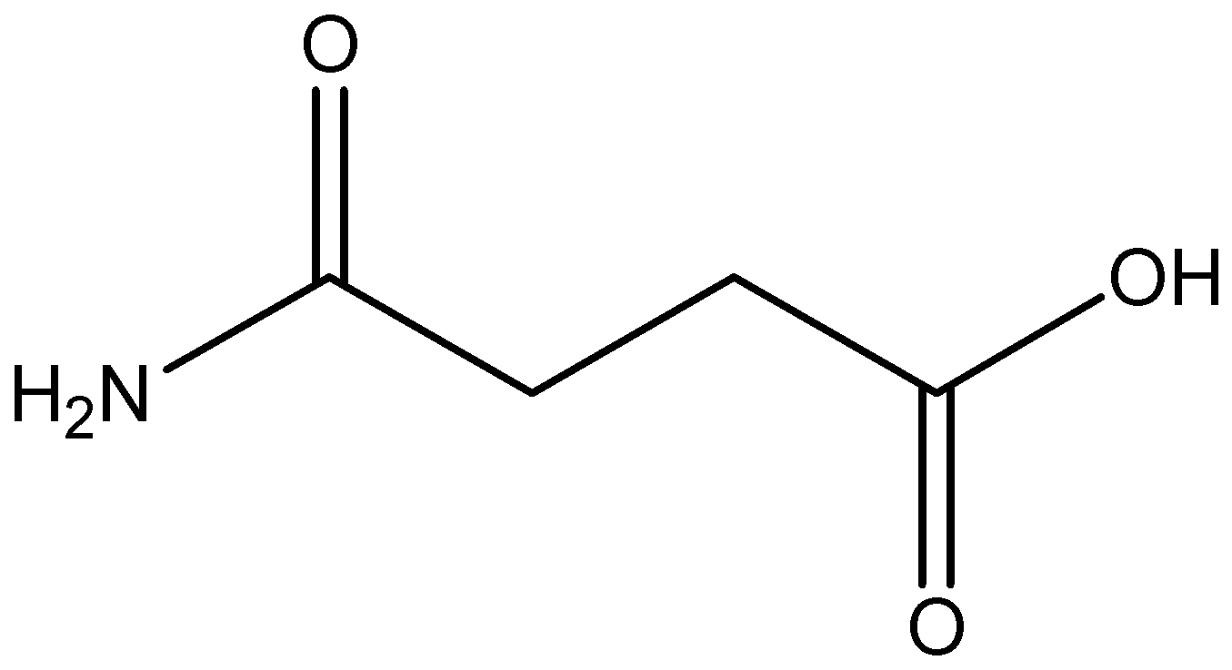
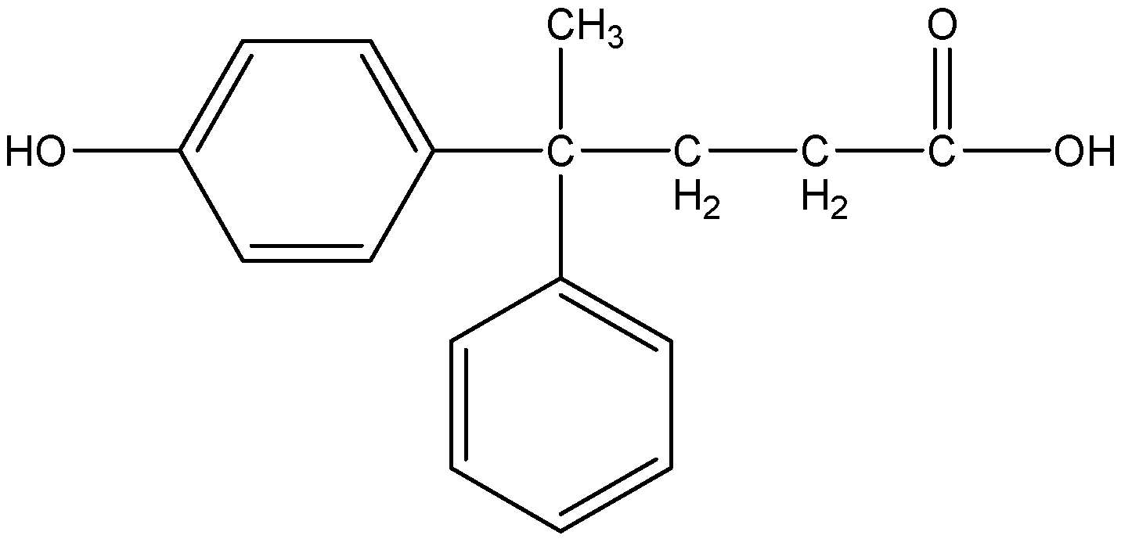
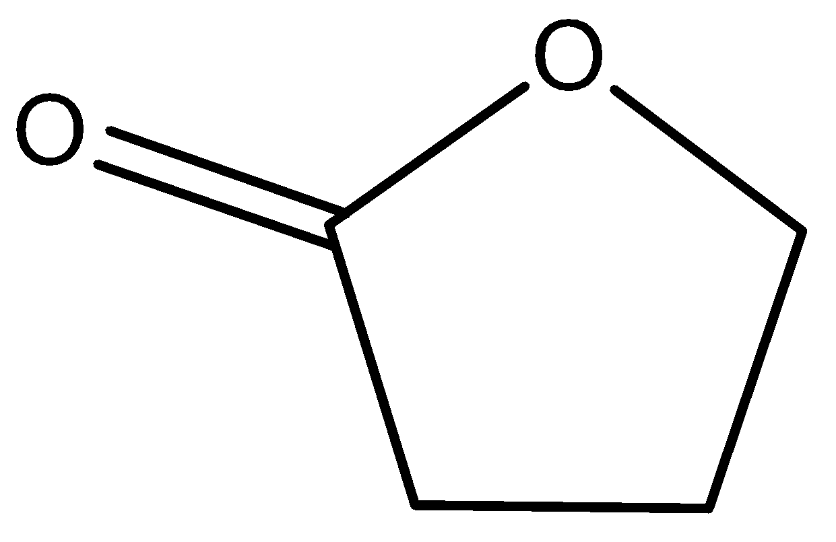
Levulinic acid as a platform chemical
butanediol
Acrylic acid
Succinic acid
MTHF
(fuel additive)
THF
Diphenolic acid
gamma
butyrolactone
DALA (δ-amino levulinic acid)
(non-toxic, biodegradable herbicide)

Slide 38
8. Reduce Derivatives
Unnecessary derivatization (blocking group, protection/deprotection, temporary modification of physical/chemical processes) should be avoided whenever possible.

Slide 39
Protecting Groups
2 synthetic steps are added each time one is used
Overall yield and atom economy will decrease
“Protecting groups are used because there is no direct way to solve the problem without them.”

Slide 40
Eg= synthesis of m-hydroxy benzoic acid from m-hydroxy benzaldehyde

Slide 41
9. Catalysis
Catalytic reagents (as selective as possible) are superior to stoichiometric reagents.Use catalyst,not stiochiometric reagents.
Eg= propene+hydrogen=propane(100%)
Ni as catalyst

Slide 42
Heterogeneous vs Homogenous
Distinct solid phase
Readily separated
Readily regenerated & recycled
Rates not as fast
Diffusion limited
Sensitive to poisons
Lower selectivity
Long service life
High energy process
Poor mechanistic understanding
Same phase as rxn medium
Difficult to separate
Expensive and/or difficult to separate
Very high rates
Not diffusion controlled
Robust to poisons
High selectivity
Short service life
Mild conditions
Mechanisms well understood

Slide 43
Heterogeneous vs Homogenous
Distinct solid phase
Readily separated
Readily regenerated & recycled
Rates not as fast
Diffusion limited
Sensitive to poisons
Lower selectivity
Long service life
High energy process
Poor mechanistic understanding
Same phase as rxn medium
Difficult to separate
Expensive and/or difficult to separate
Very high rates
Not diffusion controlled
Robust to poisons
High selectivity
Short service life
Mild conditions
Mechanisms well understood
Green
catalyst

Slide 44
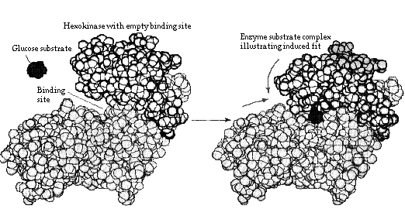
Biocatalysis
Enzymes or whole-cell microorganisms
Benefits
Fast rxns due to correct orientations
Orientation of site gives high stereospecificity
Water soluble
Naturally occurring
Moderate conditions

Slide 45
10. Design for Degradation
Chemical products should be designed so that at the end of their function they do not persist in the environment and instead break down into innocuous degradation products.

Slide 46
Persistence
Early examples:
Sulfonated detergents
Alkylbenzene sulfonates – 1950’s & 60’s
Foam in sewage plants, rivers and streams
Persistence was due to long alkyl chain
Introduction of alkene group into the chain increased degradation
Chlorofluorocarbons (CFCs)
Do not break down, persist in atmosphere and contribute to destruction of ozone layer
DDT
Bioaccumulate and cause thinning of egg shells

Slide 47
Degradation of Polymers:
Polylactic Acid
Manufactured from renewable resources
Corn or wheat; agricultural waste in future
Uses 20-50% fewer fossil fuels than conventional plastics
PLA products can be recycled or composted
Cargill Dow

Slide 48
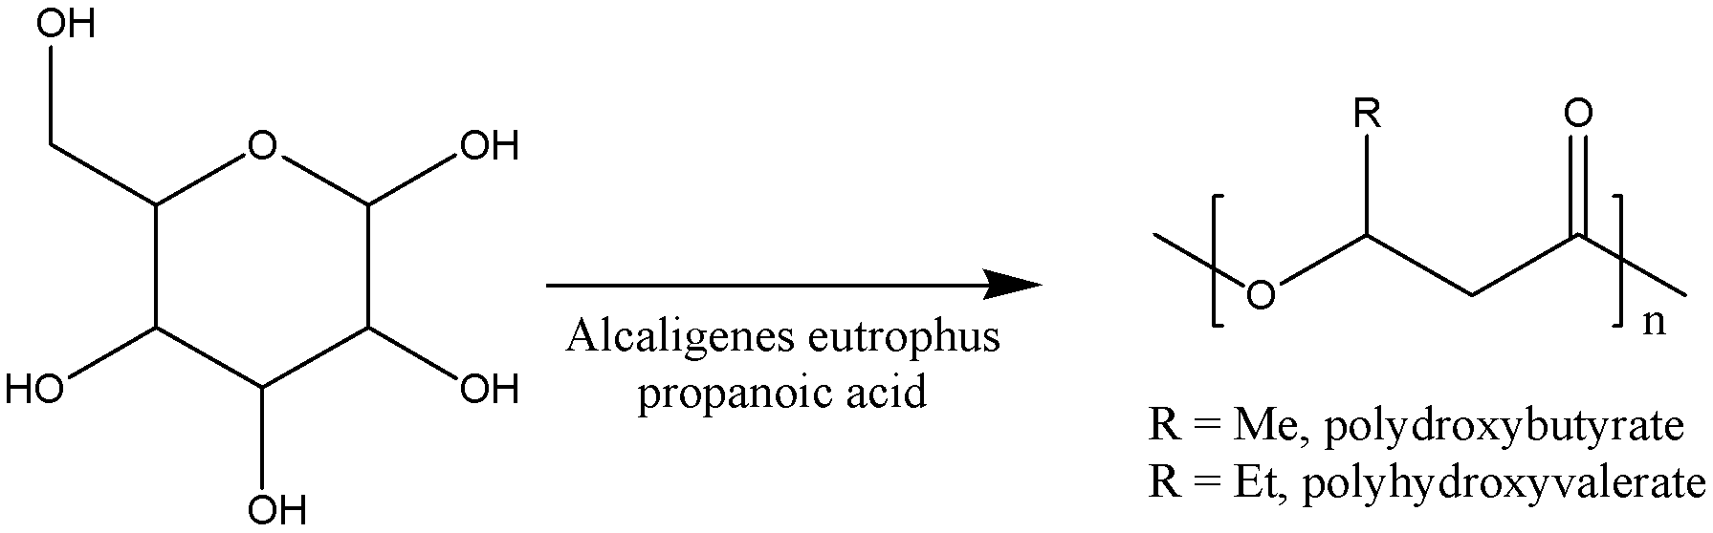
Polymers from Renewable Resources: Polyhydroxyalkanoates (PHAs)
Fermentation of glucose in the presence of bacteria and propanoic acid (product contains 5-20% polyhydroxyvalerate)
Similar to polypropene and polyethene
Biodegradable

Slide 49
11. Real-time Analysis for Pollution Prevention
Analytical methodologies need to be further developed to allow for real-time in-process monitoring and control prior to the formation of hazardous substances.

Slide 50
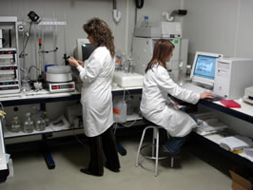

Real time analysis for a chemist is the process of “checking the progress of chemical reactions as it happens.”
Knowing when your product is “done” can save a lot of waste, time and energy!

Slide 51
12. Inherently Safer Chemistry for Accident Prevention
Substance and the form of a substance used in a chemical process should be chosen so as to minimize the potential for chemical accidents, including releases, explosions, and fires.

Slide 52

Cyanide!
Phosgene!

Slide 53
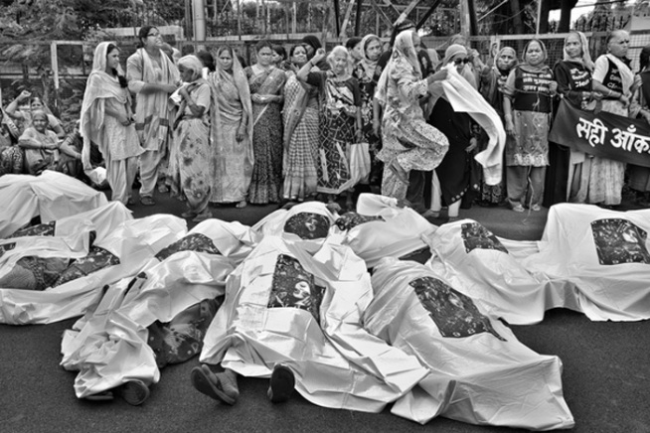
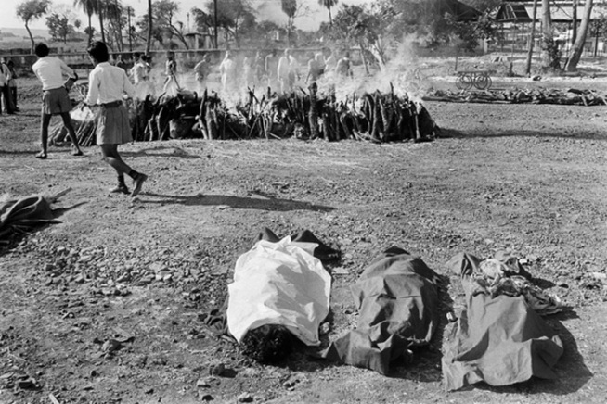
12. Inherently Safer Chemistry for Accident Prevention
Tragedy in Bhopal, India - 1984
In arguably the worst industrial accident in history, 40 tons of methyl isocyanate (MIC) were accidentally released when a holding tank overheated at a Union Carbide pesticide plant, located in the heart of the city of Bhopal. 15,000 people died and hundreds of thousands more were injured.

Slide 54
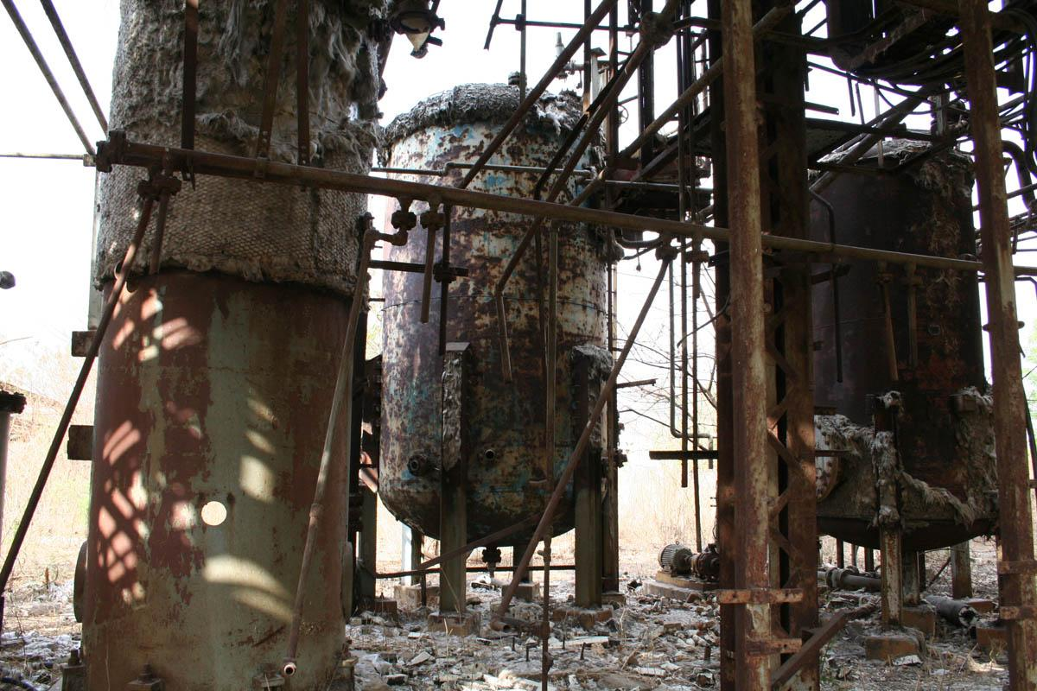
Chemists try to avoid things that explode, light on fire,
are air-sensitive, etc.
In the “real world” when these things happen, lives are lost.

Slide 55
Zero Waste Technology
Zero waste means designing and managing products and processes to systematically avoid and eliminate the volume and toxicity of waste and materials, conserve and recover all resources, and not burn or bury them.

Slide 56
Tools of green chemistry
Green starting materials
eg. Adipic acid from D-glucose
Green reagent
eg. Styrene from benzene
eg. Styrene from benzene Green reaction eg. Synthesis of ibuprofen

Slide 57
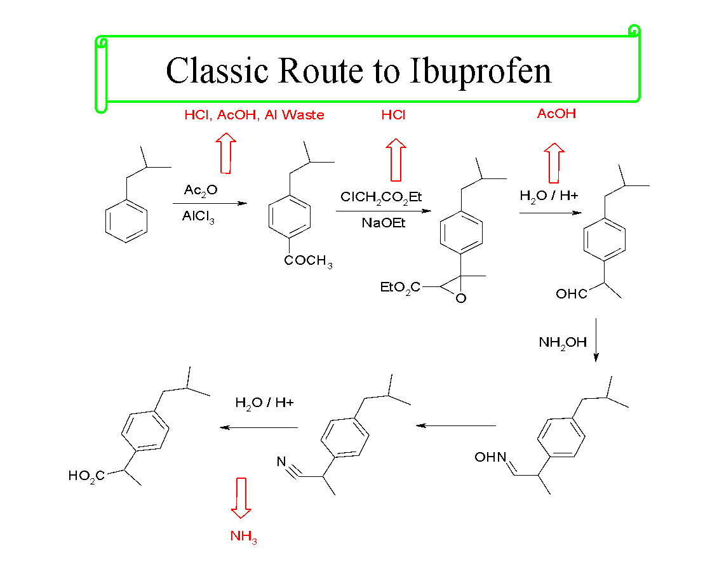

Slide 58
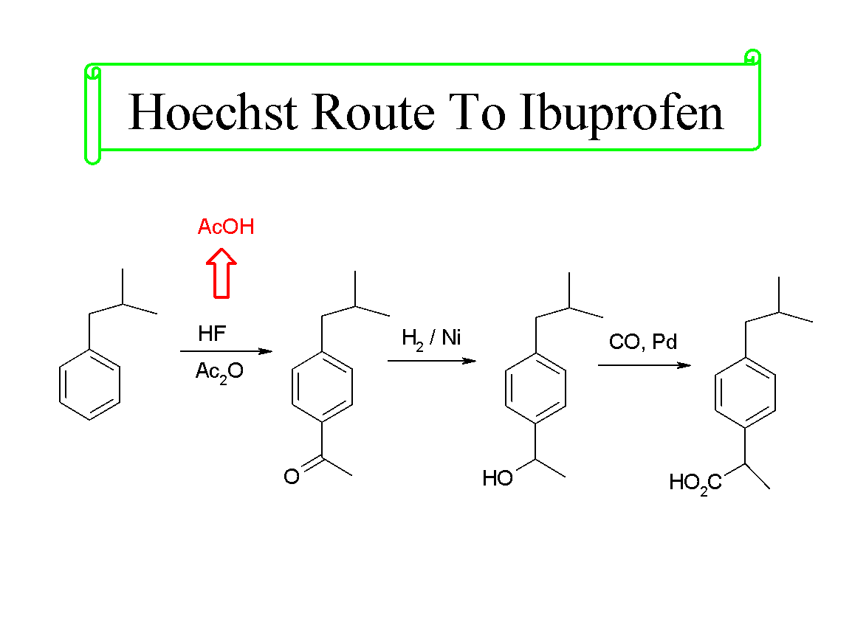

Slide 59
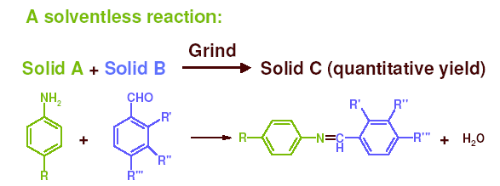
“The use of auxiliary substances (e.g. solvents, separation agents, etc.) should be made unnecessary wherever possible, and innocuous when used”

Slide 60
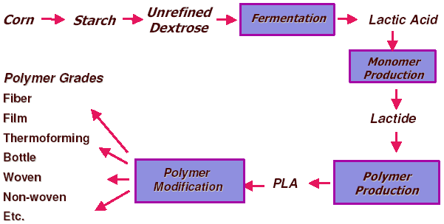
Poly lactic acid (PLA) for plastics production

Slide 61
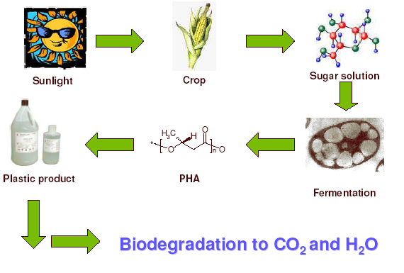
Polyhydroxyalkanoates (PHA’s)

Slide 62
Pollution Prevention Hierarchy
Prevention & Reduction
Recycling & Reuse
Increasing Greenness
Treatment
Disposal

Slide 63
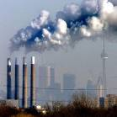
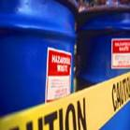

Applying CLEANER PRODUCTION to MULTILATERAL ENVIRONMENTAL AGREEMENTS
CDM
Clean Development Mechanism
A United Nations Environment Program

Slide 64
The Clean Development Mechanism (CDM) is a key tool in the Kyoto protocol, allowing countries (Annex I countries) with emission reduction targets to undertake and benefit from greenhouse gas emission reductions in other (non-Annex I) countries.

Slide 65
About Kyoto Protocol: United Nations Framework Convention on Climate Change – UNFCCC
The Kyoto Protocol is an amendment to UNFCCC that sets out specific targets to reduce GHG emissions from UNFCCC Annex I countries (or more correctly, from Kyoto Protocol Annex B countries – these are almost identical, with the exception for the few Annex I countries that have ratified UNFCCC but not the Kyoto protocol). The Kyoto protocol also provides tools and procedures for countries to work together to achieve the emission reduction targets, instead of each country only trying to achieve the targets on their own in their own country. The three key tools are:
Clean Development Mechanism (CDM)
Joint Implementation (JI)
Emission Trading

Slide 66
Annex I refers to UNFCCC and is a list of countries that are committed to support developing countries to address climate change. These are more or less identical with the developed countries and economies in transition (former soviet union bloc members).
Annex B refers to the Kyoto Protocol and is a list that states the emission target for each country in Annex I.
However, as not all Annex I countries have ratified the Kyoto Protocol (notably USA), these two lists are not exactly the same. However, to avoid confusion the two terms are often use interchangeably.

Slide 67
Kyoto Protocol:
Signed in 1997; in force since 16 February 2005.
Ratified by more than 130 countries
> Major non participants: USA and Australia.
Commits Annex 1 countries to reducing greenhouse gas emissions.
> GHG emissions may be reduced by ~ 5% below 1990 levels in 2008-2012;
> Individual, quantified emission targets for each industrialized country;
> 6 greenhouse gas covered: CO2, CH4, N2O, HFC, PFC, SF6.
3 flexibility mechanisms for financing emission reduction abroad.
> Clean Development Mechanism (CDM)
> Joint Implementation (JI)
> International Emissions Trading (ET)
Notes:
Slide 3 – About Kyoto Protocol
As is explained in more detail in module 3: “Introduction to UNFCCC”, the Kyoto Protocol is an amendment to UNFCCC that sets out specific targets to reduce GHG emissions from UNFCCC Annex I countries (or more correctly, from Kyoto Protocol Annex B countries – these are almost identical, with the exception for the few Annex I countries that have ratified UNFCCC but not the Kyoto protocol). The Kyoto protocol also provides tools and procedures for countries to work together to achieve the emission reduction targets, instead of each country only trying to achieve the targets on their own in their own country. The three key tools are:
Clean Development Mechanism (CDM)
Joint Implementation (JI)
Emission Trading

Slide 68

OVERVIEW
CDM: the basic idea
What is the Clean Development Mechanism (CDM) ?
> A mechanism that allows Annex B Countries to undertake GHG emission reduction projects in non-annex B countries, and to use the achieved emission reductions to meet their own emission goal.
> In CDM projects, the Annex B country fund the project and provides any necessary know-how and technology transfer to the non-annex B country where the project is implemented.
> CDM works because emission reductions are many times more expensive to achieve in Annex B countries than in non-Annex B countries (the opportunities for emission reduction are bigger there).
Make difference between Annex I and Annex B countries!
Notes:
Slide 4 – CDM: the basic idea
This slide explains the basic idea with CDM.
To avoid confusion, please explain that:
Annex I refers to UNFCCC and is a list of countries that are committed to support developing countries to address climate change. These are mor3e or less identical with the developed countries and economies in transition (former soviet union bloc members).
Annex B refers to the Kyoto Protocol and is a list that states the emission target for each country in Annex I.
However, as not all Annex I countries have ratified the Kyoto Protocol (notably USA), these two lists are not exactly the same. However, to avoid confusion the two terms are often use interchangeably.

Slide 69
Examples of CDM projects
Notes:
Slide 5 – Examples of CDM projects opportunities

Slide 70
OVERVIEW
CDM organisation and objectives
Rules, modalities and procedures of CDM are defined in:
> Kyoto Protocol;
> Follow-up decisions of COP;
> Decisions of CDM Executive Board.
CDM EB (Executive Board):
> Responsible for further development of CDM rules, and supervising implementation;
> Composed of 10 members + 10 alternates;
> Reports to the COP (Conference of the Parties).
Twin objectives of CDM:
> Help Annex 1 countries meet their objectives in a cost-effective way;
> Contribute to sustainable development of the host country.
Notes:
Slide 7 – CDM organization and objectives
The practical function of CDM is defined in detail in the Kyoto Protocol and in a number of follow-up decisions by COP as well as in supporting documents issued by different bodies in UNFCCC. The most important body is the Executive Board.
The basic requirement for any CDM project are:
Actual and real reductions of GHG emissions must be achieved.
The project must contribute to sustainable development in the country where the CDM project is implemented

Slide 71
BASICS
Additionality and baselines
“A project is eligible for CDM if greenhouse gas emissions are reduced below those that would have occurred in the absence of the CDM project.”
GHG emissions (tCO₂eq)
1. Validation of project design, baseline and monitoring plan
2. Verification / Certification of emission reductions
Emissions baseline
ADDITIONAL EMISSION REDUCTIONS
Emissions after the project
Years
Project implementation
Notes:
Slide 8 – Additionality and baselines
Additionality: A CDM project is additional if anthropogenic emissions of greenhouse gases by sources are reduced below those that would have occurred in the absence of the CDM project.
Baseline: The baseline for a CDM project is the scenario that reasonably represents the anthropogenic emissions by sources of greenhouse gases that would occur in the absence of the proposed project. The method for calculating the baseline is a key challenge for many CDM projects, and ach new baseline methodology need to be approved by the Executive Board. In principle, each type of CDM project has to have its own baseline methodology. Once this methodology id developed and approved, other projects of the same type can use the same baseline methodology to calculate their baseline emissions.

Slide 72
BASICS
Where is CDM applicable ?
Renewable energy > Wind power > Solar > Biomass power > Hydro power | Waste management > Capturing of landfill methane emissions to generate power > Utilisation of waste and waste water emissions for generation of energy
Energy efficiency measures > Boiler and steam efficiency > Pumps and pumping systems > Efficient cooling systems > Back pressure turbines > etc…
Cogeneration in industries having both steam and power requirements
Power sector > Induction of new technologies which are efficient (thermal) > Reduction in technical T&D losses
Fuel switching > From fossil fuel to green fuel like biomass…
Electrical energy saving 1 kWh = 0.8 ~ 0.9 kg CO₂
Power generation (waste heat / renewable) 1 MW = 4.000 ~ 5.000 t CO₂
Coal saving 1 kg = 1.3 ~ 1.6 kg CO₂
Fuel oil saving 1 litre oil = 3 ~ 3.5 kg CO₂
NG based power generation 1 kWh generation = 0.35 ~ 0.45 kg CO₂ 1 kg NG burning/saving = 2.4 ~ 2.5 kg CO₂
Notes:
Slide 11 – Where is CDM applicable ?
Examples of eligible projects:
- Fuel switch to lower carbon intensive fuels
- Installations based on renewable energy
- Combined heat and power (CHP)
- Supply-side energy efficiency improvements
- End-use energy efficiency improvements
- Agriculture sector (except land-use change)
- Reduction in methane emissions
- Reforestation/afforestation projects
The box in this slide indicates how different savings may be translated to GHG emissions. Please note that this is only indicative!

Slide 73
Environmental Impact Assessment
Environmental Impact Assessment (EIA) is a process of evaluating the likely environmental impacts of a proposed project or development, taking into account inter-related socio-economic, cultural and human-health impacts, both beneficial and adverse.

Slide 74
Environment Impact Assessment (EIA) :Definition
Environmental Impact Assessment is
✓
A formal process for identifying:
likely effects of activities or projects on the ENVIRONMENT, and on human health and welfare.
means and measures to mitigate & monitor these impacts
Environment is broadly interpreted: physical, biological, and social.
In EIA, the term “impacts” is used instead of “effects of activities.”
What is an impact?
Notes:
Aspects of the environment:
Physical: soil & water resources, air quality
Biological: fauna, flora, ecosystem
Social: human health and welfare, culture, religion, and local values
Or: Economical, social and eco-systemic

Slide 75
What is an impact?
The impact of an activity is a deviation (a change) from the baseline situation that is caused by the activity.
The baseline situation is the existing environmental situation or condition in the absence of the activity.
The baseline situation is a key concept in EIA.
!
To measure an impact, you must know what the baseline situation is.
More…

Slide 76
The baseline situation
Water Quantity, quality, reliability, accessibility
In characterizing the baseline situation, many environmental components MAY be of interest
Soils Erosion, crop productivity, fallow periods, salinity, nutrient concentrations
Fauna Populations, habitat
The components of interest are those that are likely to be affected by your activity—or upon which your activity depends for its success
Env Health Disease vectors, pathogens
Flora Composition and density of natural vegetation, productivity, key species
Special Key species ecosystems
Notes:
For example, an ecotourism activity might depend on water level in watering holes---but this environmental component is not in fact affected by your activity.

Slide 77
EIA would necessarily involve the following stages:
1.Screening to determine which projects or developments require a full or partial impact assessment study;
2.Scoping to identify which potential impacts are relevant to assess (based on legislative requirements, international conventions, expert knowledge and public involvement), to identify alternative solutions that avoid, mitigate or compensate adverse impacts on biodiversity (including the option of not proceeding with the development, finding alternative designs or sites which avoid the impacts, incorporating safeguards in the design of the project, or providing compensation for adverse impacts), and finally to derive terms of reference for the impact assessment;

Slide 78
3. Assessment and evaluation of impacts and development of alternatives, to predict and identify the likely environmental impacts of a proposed project or development, including the detailed elaboration of alternatives;
4.Reporting the Environmental Impact Statement (EIS) or EIA report, including an environmental management plan (EMP), and a non-technical summary for the general audience.
5. Review of the Environmental Impact Statement (EIS), based on the terms of reference (scoping) and public (including authority) participation.

Slide 79
6. Decision-making on whether to approve the project or not, and under what conditions; and
7. Monitoring, compliance, enforcement and environmental auditing. Monitor whether the predicted impacts and proposed mitigation measures occur as defined in the EMP. Verify the compliance of proponent with the EMP, to ensure that unpredicted impacts or failed mitigation measures are identified and addressed in a timely fashion.

Slide 80
The Full EIA study
✓
In summary,
The full EIA study is a far more significant effort than the preliminary assessment.
It is reserved for activities for which screening or the preliminary assessment shows that significant impacts are likely.
Notes:
The purpose of a Full EIA study is not to find that impacts will not be significant. Its purpose is to allow an informed decision to be made about which significant environmental impacts may be acceptable to obtain a particular development objective. The preliminary assessment cannot serve this function.

Slide 81
Conclusion
Green chemistry Not a solution to all environmental problems But the most fundamental approach to preventing pollution.

Slide 82
Thank you

